Slide 1
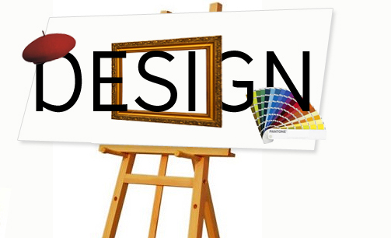
Software Development Lifecycle (SDLC) - Design Phase

Slide 2
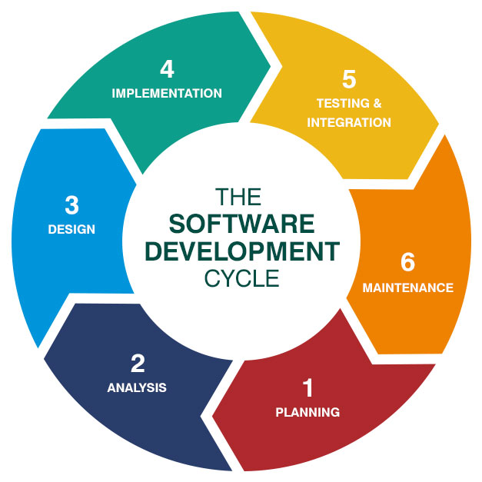
Design Phase and SDLC
The Design Phase is a crucial element of the Software Development Life Cycle (SDLC), marking the transition from the conceptual understanding of requirements to exact implementation details.

Slide 3
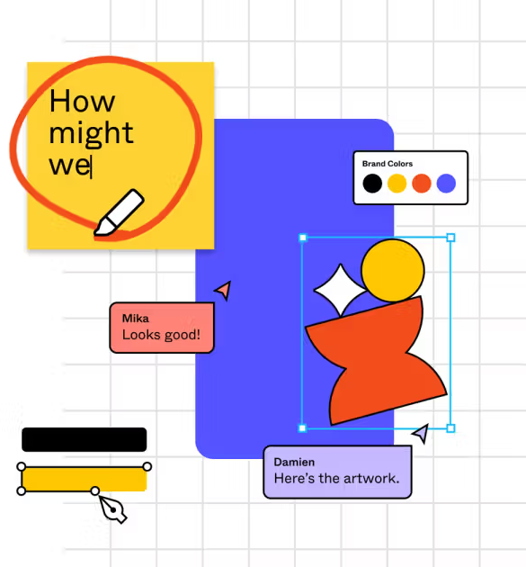
Introduction to the Software Design Phase
The software design phase transforms ideas into structured designs, laying the foundation for development.
Similar to an architect's blueprint for a house, this phase creates a detailed plan for the software.
Results in a comprehensive design document that guides developers.
Key focus: aligning designs with business goals, technical requirements, and user needs.

Slide 4
Roles and Responsibilities in the Design Phase
Client: Provides industry-related data, reviews materials prepared by the team, and gives approval for project accomplishments.
UX Designer: Ensures that the product interface designs are user-centered and logical.
Project Manager: Heads the project and makes critical decisions to ascertain a successful outcome.
Business Analyst: Molds product requirements for UX designers and assesses the designs they generate.
Technical Architect: Decides on the software’s architecture, technology stack, and integration strategies with other systems.
Software Developer: Assists clients in translating their requirements into product features and create an original code for the product.
QA Specialist: Analyzes requirements and tests product designs to ensure faultlessness.

Slide 5

Key Software Elements in Design
System Architecture: Defines high-level structure, focusing on scalability, reliability, and maintainability.
Modules: Integration points for external APIs; ensure compatibility and seamless connectivity.
Software Components: Building blocks requiring high cohesion and low coupling for flexibility.
Interfaces: Simplify and standardize communication between components.
Data: Ensure integrity, security, and efficiency in data management.

Slide 6
Steps to Design Software
Evaluate Technology and Framework Options:
Research and choose a tech stack based on scalability, performance, and compatibility.
Design High-Level Structure:
Create architectural patterns, define components, and establish data flow.
Detailing and Modeling:
Use tools like UML to produce detailed component specifications.
Review and Validate:
Involve stakeholders for feedback; iterate and refine designs before development.

Slide 7
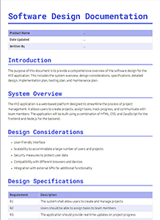
Benefits of a Comprehensive Design Document
Provides a single source of truth for developers and stakeholders.
Reduces miscommunication and confusion during development.
Ensures alignment with requirements from the Requirements Analysis phase.
Aids in identifying potential risks early in the SDLC.
Facilitates easier onboarding for new team members.

Slide 8

Importance of a Well-Designed Software
1. Clear Vision and Blueprint
2. Reduces Risks
3. Cost-Effectiveness
4. Improves Efficiency
5. Facilitates Communication
6. Ensures Quality
7. Encourages Innovation
8. Supports Scalability and Maintenance
By dedicating time and resources to the design phase, projects are more likely to succeed, meet objectives, and satisfy stakeholders.
Notes:
The design phase is critical in any project or development process because it establishes the foundation for success. Here's why it is important:
Clear Vision and Blueprint: It provides a detailed plan or blueprint of what is to be built, ensuring all stakeholders share a common understanding of the project goals and deliverables.
Reduces Risks: Proper design helps identify potential challenges, conflicts, or limitations early in the process, reducing the risk of costly errors during implementation.
Cost-Effectiveness: Addressing issues during the design phase is significantly cheaper and less time-consuming than fixing problems during development or deployment.
Improves Efficiency: A well-thought-out design streamlines the development process by setting clear guidelines, which reduces ambiguity and ensures smooth execution.
Facilitates Communication: It acts as a communication tool between team members, clients, and stakeholders, ensuring everyone is aligned and can provide input before actual implementation begins.
Ensures Quality: A comprehensive design ensures that all requirements are met and that the final product will perform as expected, leading to higher quality outcomes.
Encourages Innovation: The design phase is the best time to explore creative solutions and test innovative ideas without the constraints of later development phases.
Supports Scalability and Maintenance: A well-designed project is easier to scale, upgrade, and maintain in the future, as it incorporates flexibility and foresight into the structure.
By dedicating time and resources to the design phase, projects are more likely to succeed, meet objectives, and satisfy stakeholders.

Slide 9


3 UI/UX Mistakes to Avoid During Design Phase examples
The design lacks of contrast
The Good: Contrast in Design

Slide 10
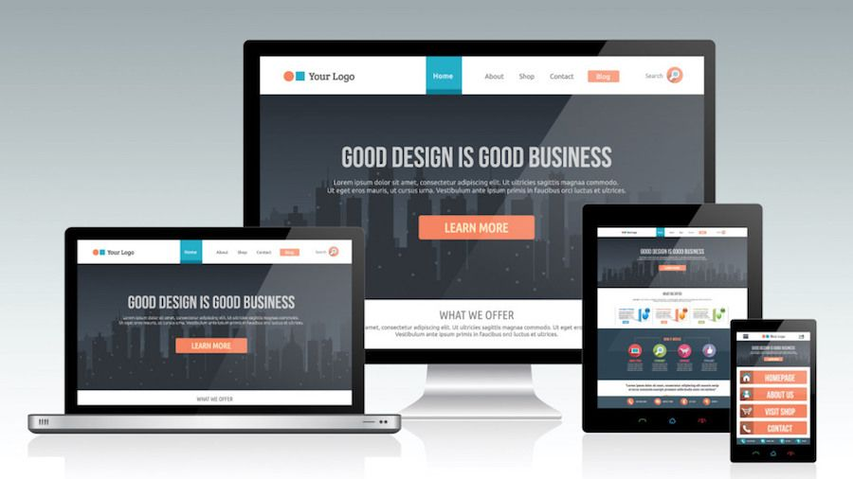
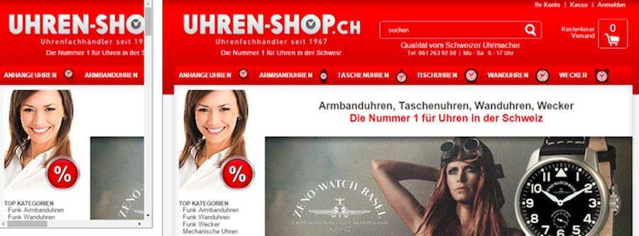
3 UI/UX Mistakes to Avoid During Design Phase examples
2. Not-responsive design
The Good: Responsive Design

Slide 11
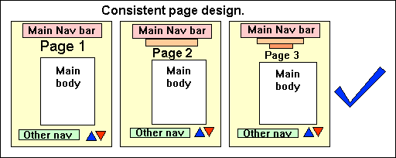
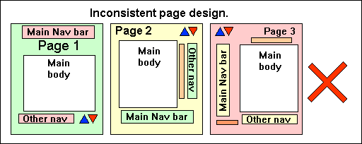
6 UI/UX Mistakes to Avoid During Design Phase examples
3. Inconsistent style
The Good: Consistent Page Design

Slide 12

Thank you for your attention!

